Slide 1

CLASS 16 :JavaScript Objects and Arrays

Slide 2
Introduction: Organizing Data
Introduction: Organizing Data
Why Objects and Arrays?
Arrays: Ordered collections of data (lists)
Objects: Unordered collections of key-value pairs (dictionaries)
Together, they form the foundation of data organization in JavaScript
Real-world Analogy:
Array: Like a shopping list - items in a specific order
Object: Like a person's profile - name, age, email as key-value pairs

Slide 3
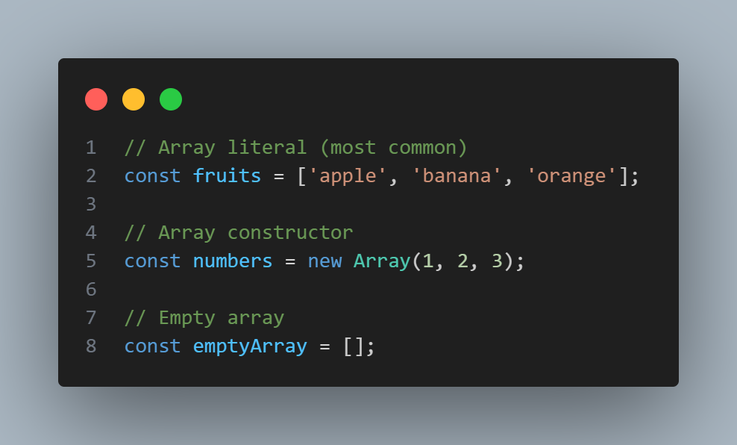
Part 1: Arrays Deep Dive
Creating and Accessing Arrays
Different ways to create arrays:

Slide 4
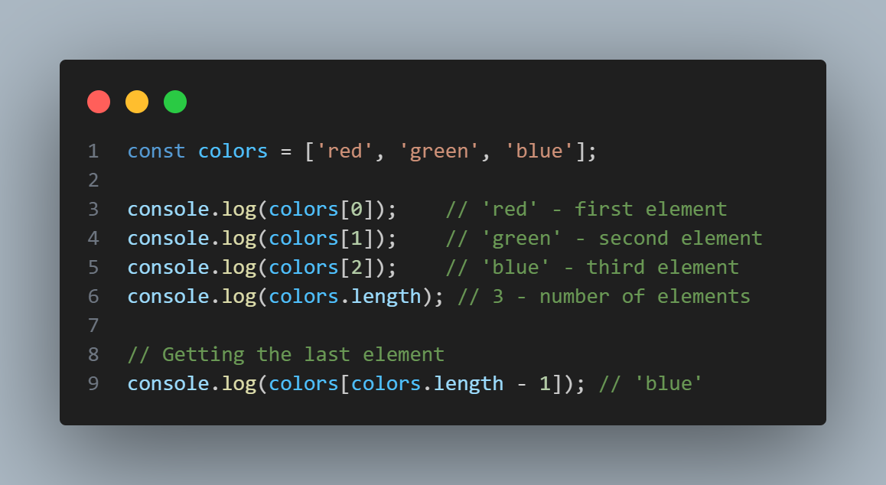
Part 1 cont’d
Accessing Array Elements:

Slide 5
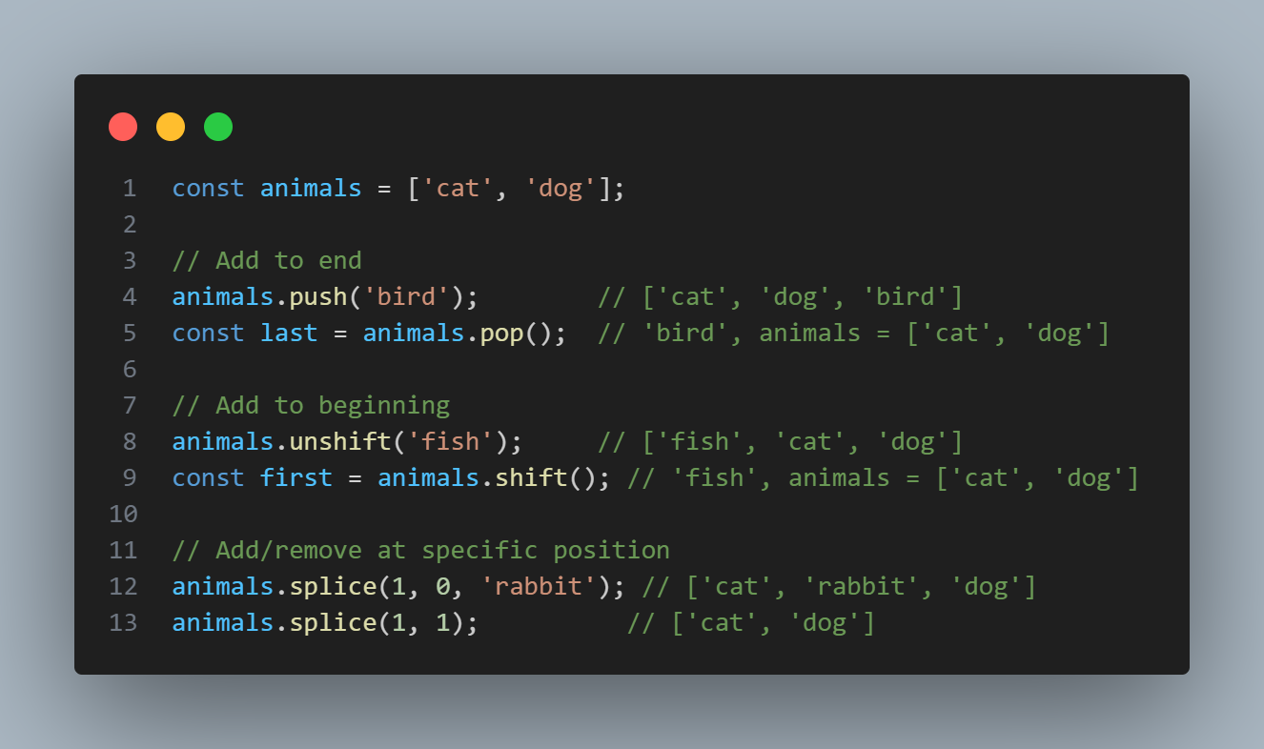
Part 1 cont’d
Common Array Methods
Adding/Removing Elements:

Slide 6
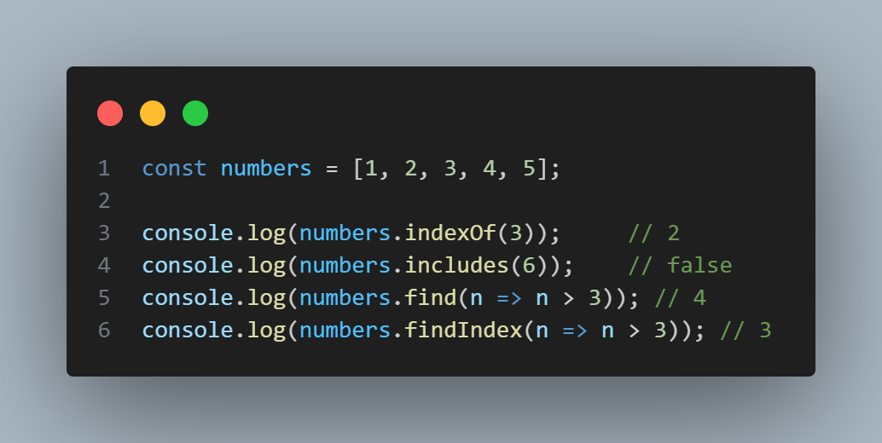
Part 1 cont’d
Finding Elements:

Slide 7
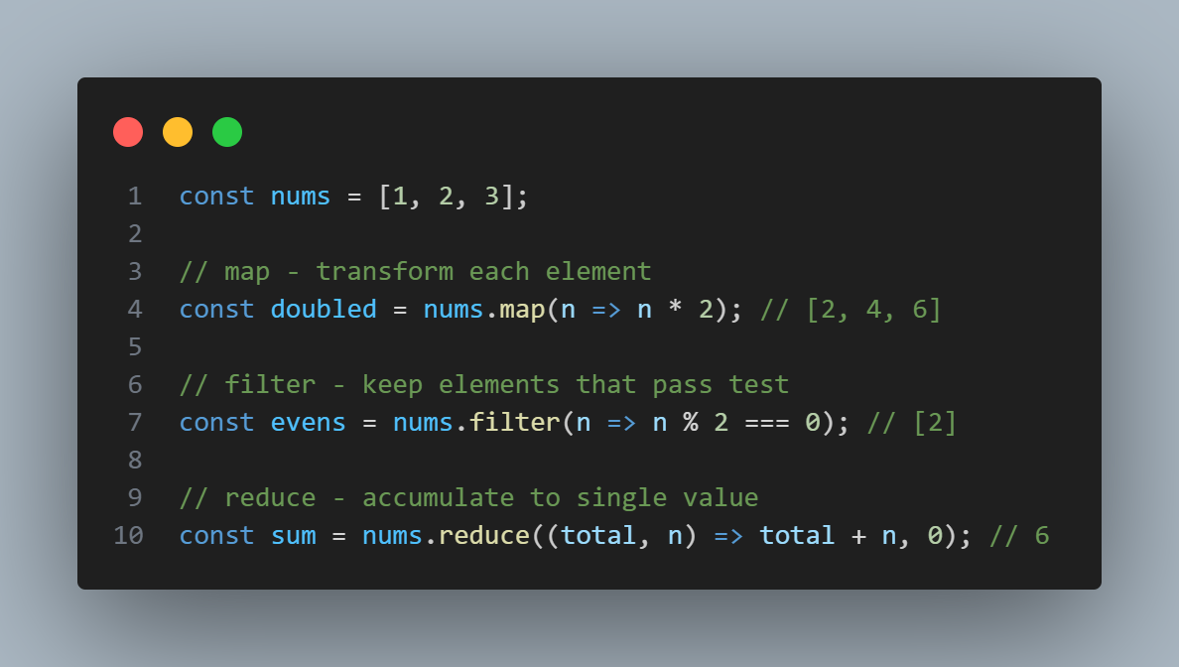
Part 1 cont’d
Transforming Arrays:

Slide 8
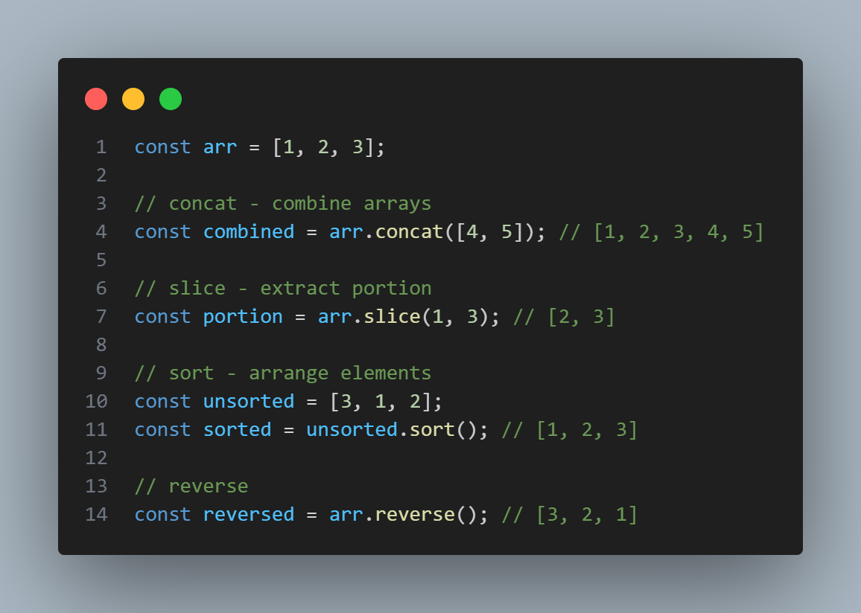
Part 1 cont’d
Other Useful Methods:

Slide 9
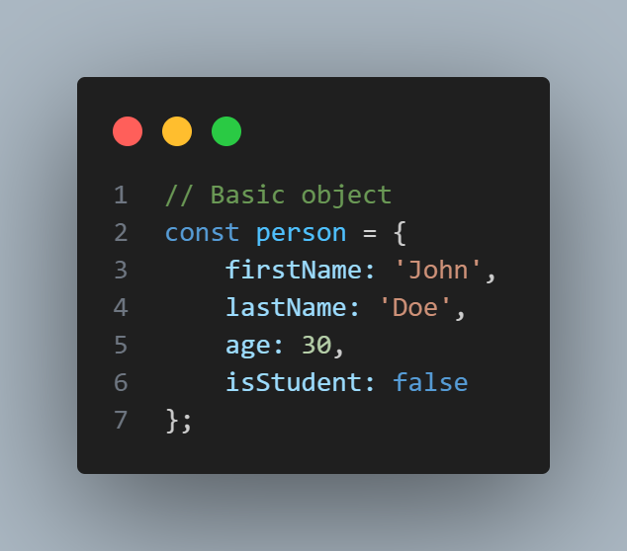
Part 2: Objects Deep Dive
Creating and Accessing Objects
Object Literal Syntax:

Slide 10
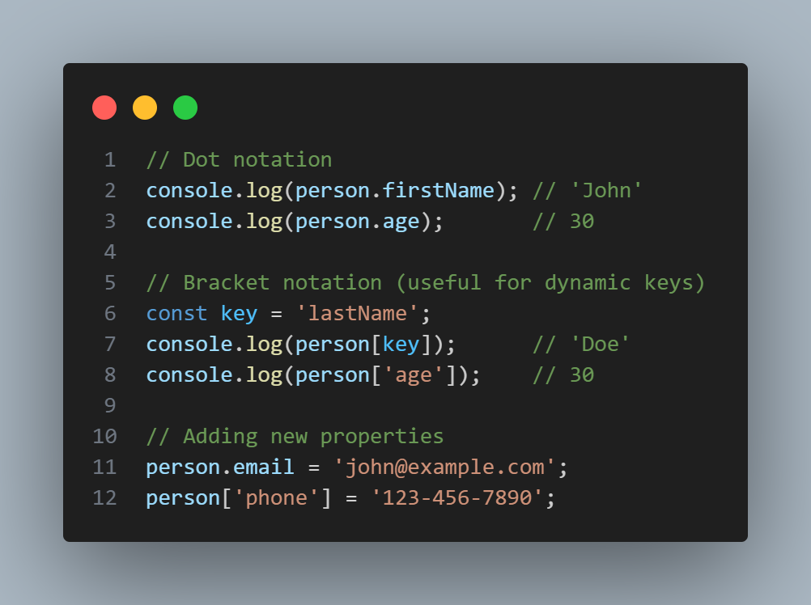
Part 2 cont’d
Accessing Properties:

Slide 11
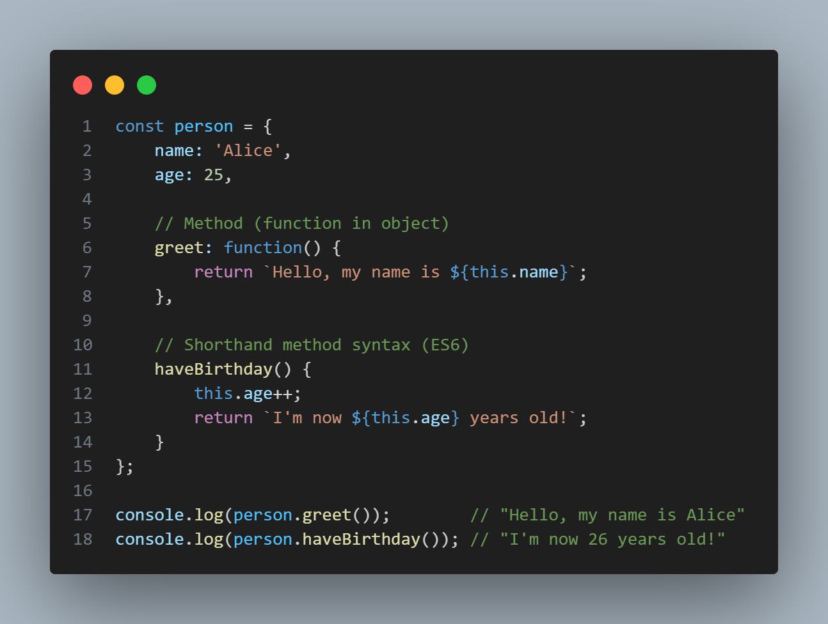
Part 2 cont’d
Objects Methods and ‘this’
Methods in Objects:

Slide 12
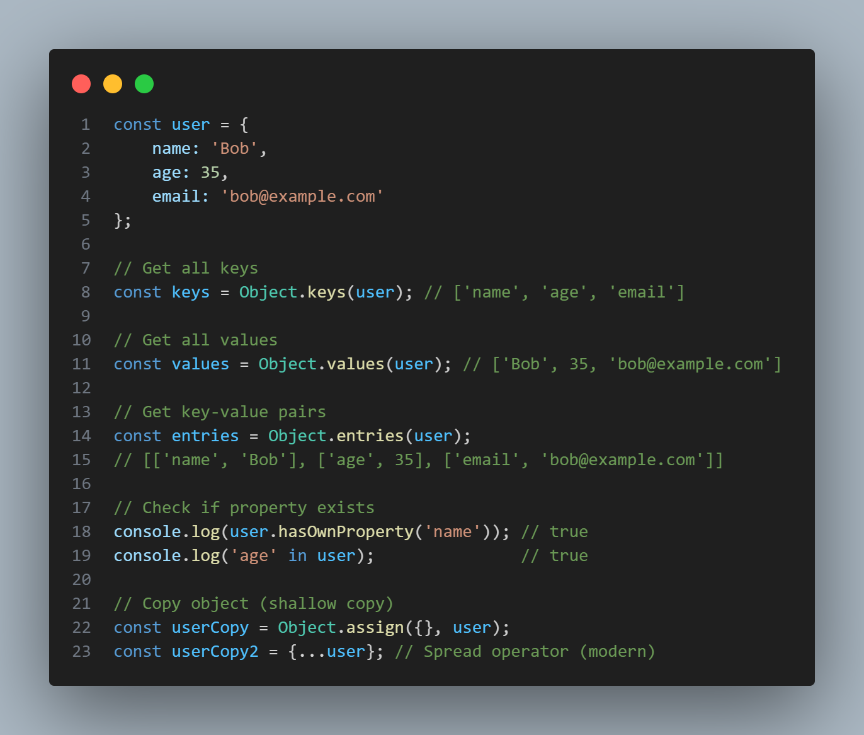
Part 2 cont’d
Common Object Methods

Slide 13
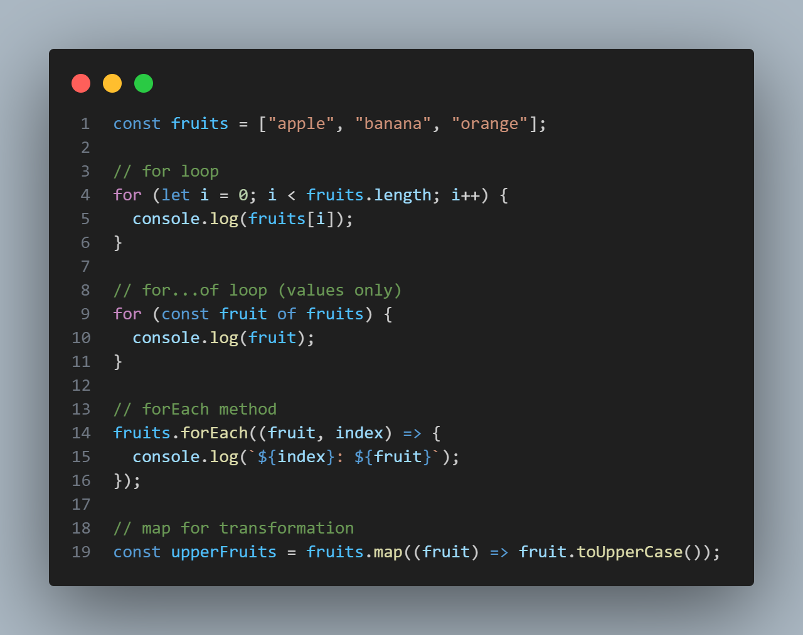
Part 3: Looping Through Arrays and Object
Looping through Arrays
Different ways to loop:

Slide 14
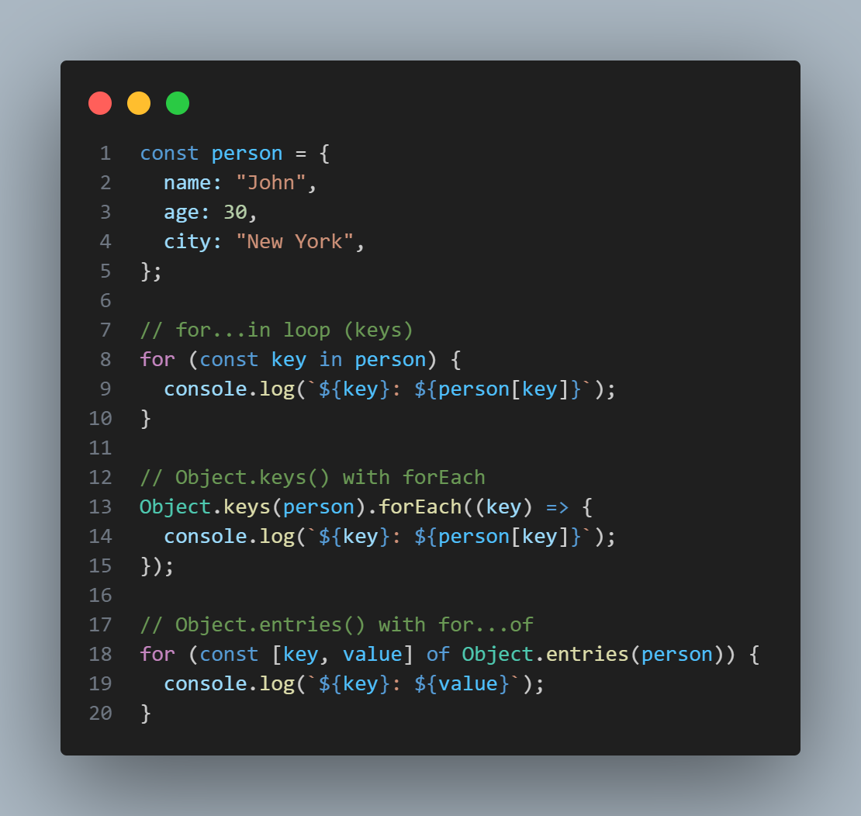
Part 3 cont’d
Looping through Objects
Different ways to loop:

Slide 15
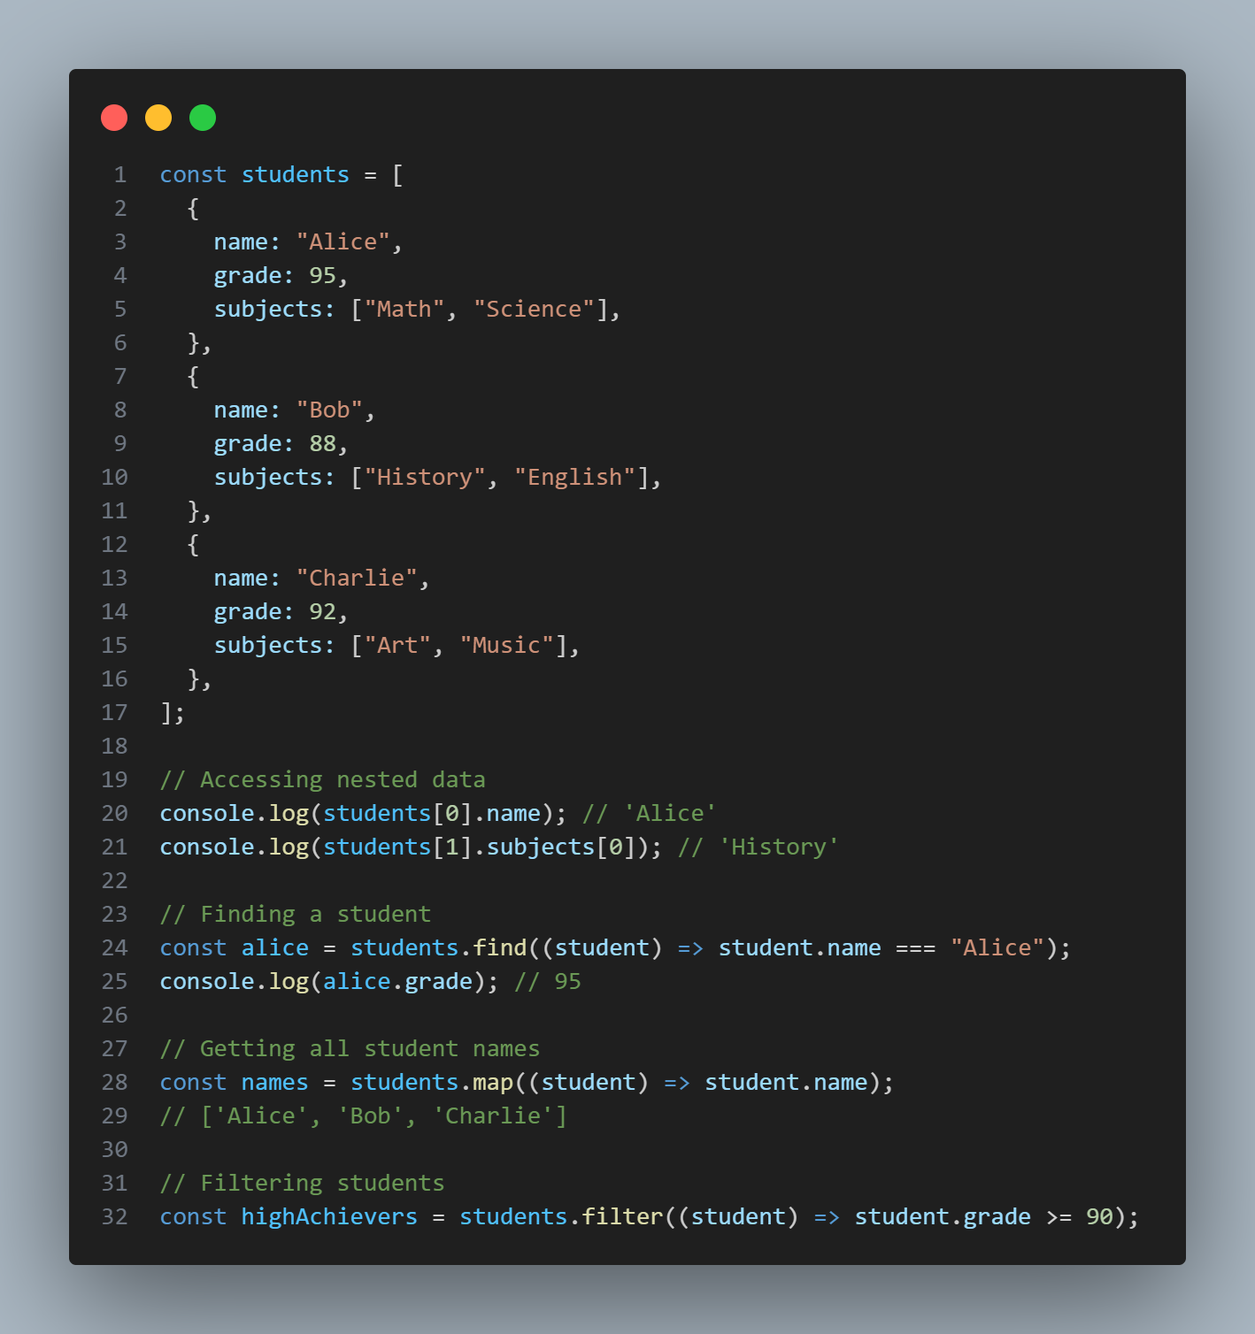
Part 4: Combining Arrays and Objects
Arrays of Objects

Slide 16
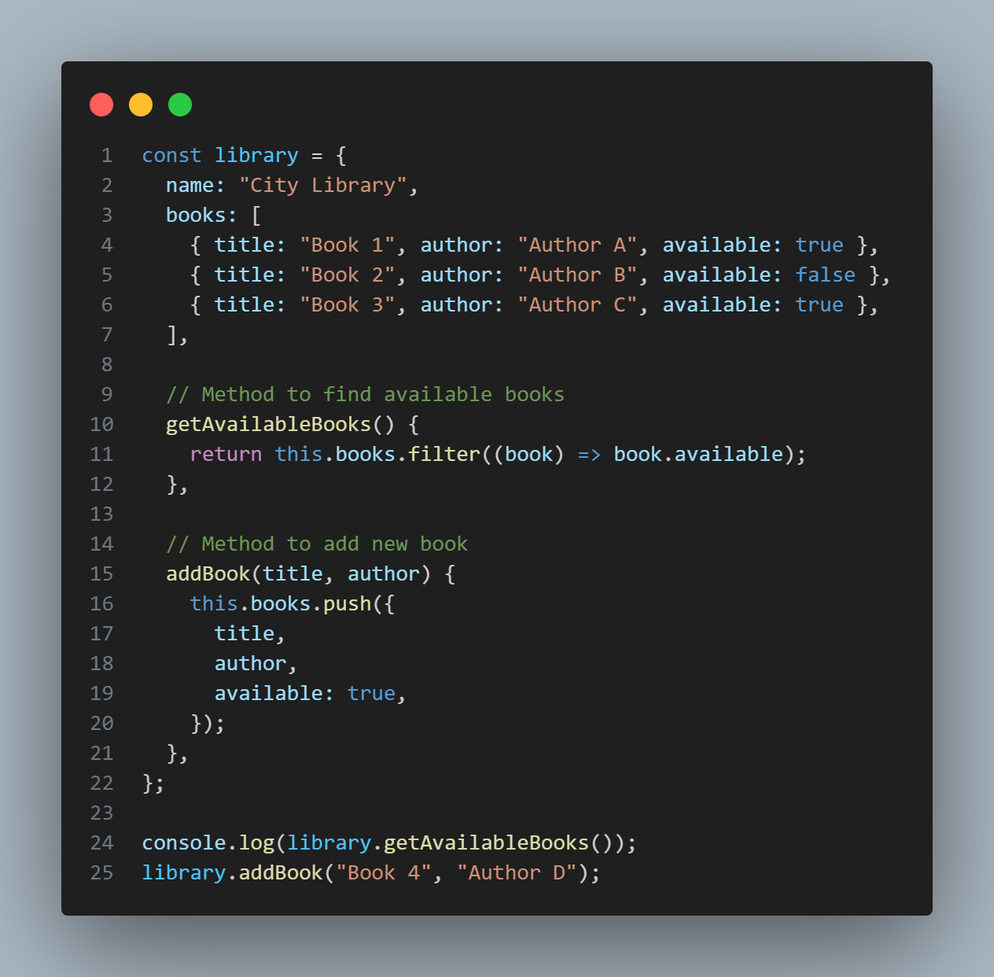
Part 4: Combining Arrays and Objects
Objects with Array Properties

